Slide 1


Ethereum Node & Dapp application
Enrico giulio maria verzegnassi
github.com/IlVerz/PervasiveSubject
slideshare.net/enricoverzegnassi

Slide 2
Ethereum - 2015
Distributed computing platform
Ether cryptocurrency (+ GAS )
Operating system (EVM) featuring smart contract
Notes:
Blockchain
Turing complete
Ethereum Virtual Machine (EVM) < GAS
Ether is a cryptocurrency

Slide 3
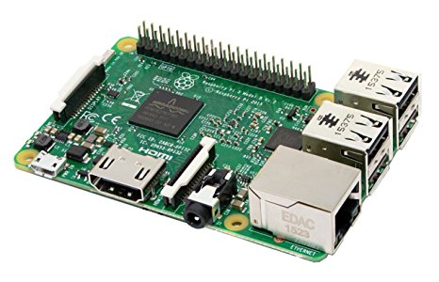


Ethereum node

Slide 4
Ethereum – Archlinux installation
Why?
Extremely fast
Always updated
High configurable
Direct access almost all linux software
How install it?
Partitionate the microsd
Download the tar.gz from https://archlinuxarm.org/ and extract it in the microsd
Plug in into the raspberry
Ssh to connect
Notes:
Then update the software
SSH connection
Create a n

Slide 5
Ethereum – Create an account
Instal the client: go-ethereum
Create a new linux user
Create an account (Public / Private key pair ): /usr/bin/geth --datadir "./ethereum" account new

Slide 6
Ethereum – Fast node installation
Select type of syncronization
Change the default directory
Limit consume usage of ram and bandwith
START!
geth --syncmode fast--cache 64 --maxpeers 12 --datadir "./ethereum"
Notes:
"Full" Sync: Gets the block headers, the block bodies, and validates every element from genesis block.
Fast Sync: Gets the block headers, the block bodies, it processes no transactions until current block - 64(*). Then it gets a snapshot state and goes like a full synchronization.
Light Sync: Gets only the current state. To verify elements, it needs to ask to full (archive) nodes for the corresponding tree leaves.

Slide 7

Ethereum – Node running
Notes:
I’m supporting the Ethereum network now!

Slide 8
Ethereum - Console
Open the console: geth --datadir "./ethereum" attach Check your balance: (Open the console) web3.fromWei(eth.getBalance(eth.coinbase), "ether")
Start Mining: (Open the console) miner.start()

Slide 9
Decentralized Application

Slide 10
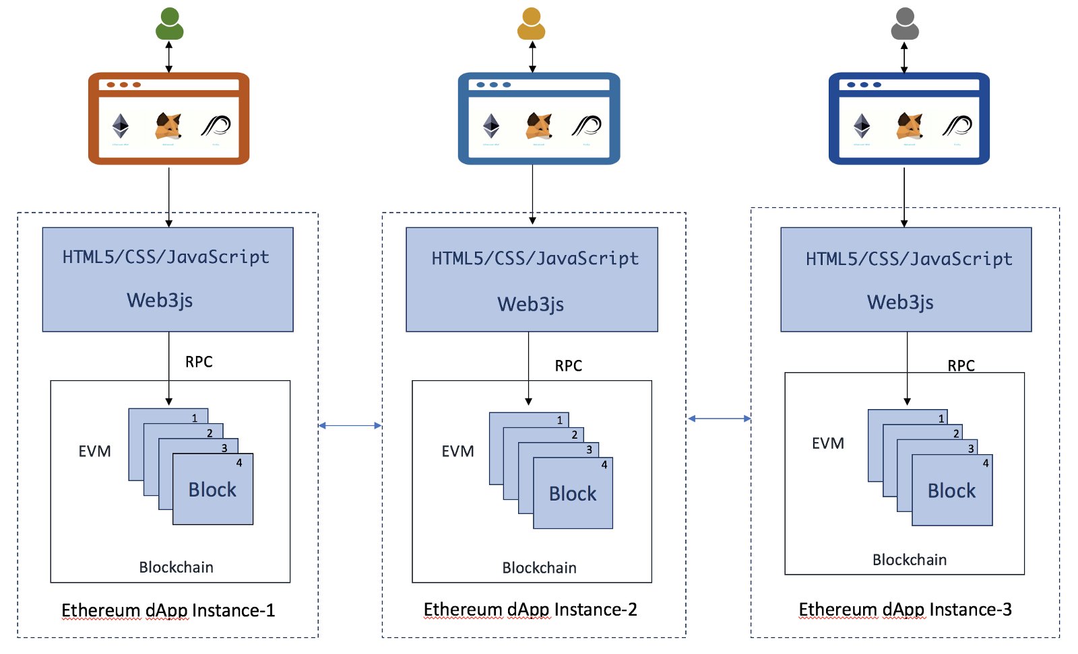
Decentralized application (DAPP)
Notes:
Ethereum Mist
Metamask
Parity
Are different way to access the Ethereum network

Slide 11
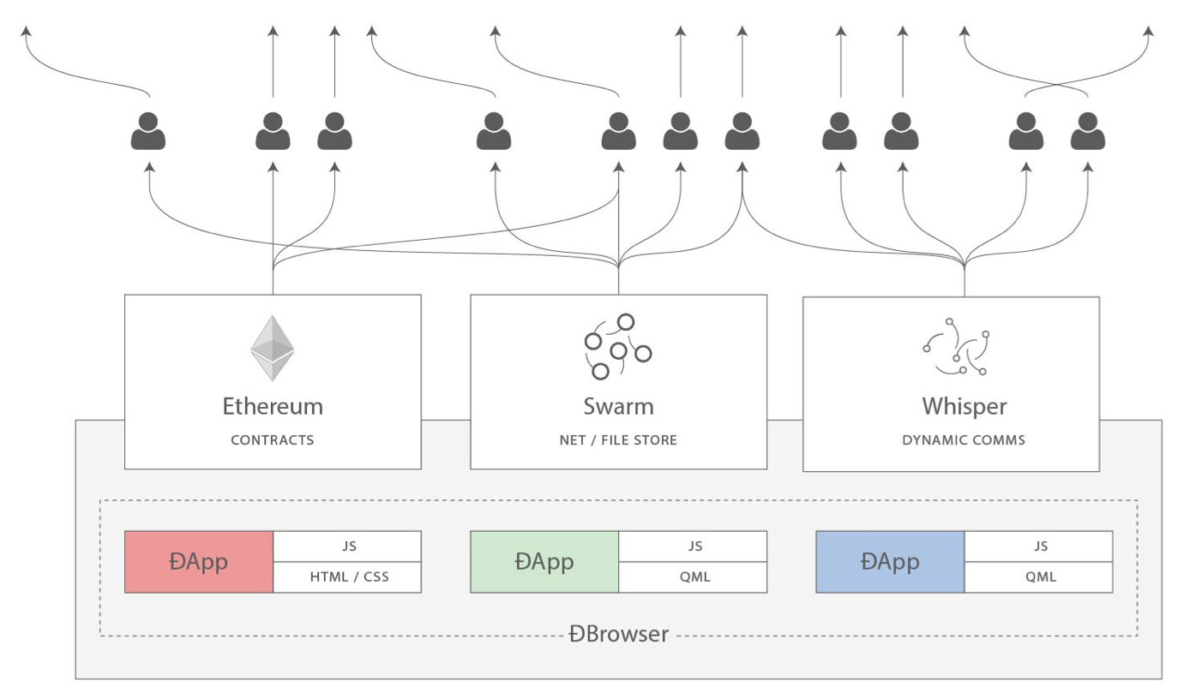
FULLY DAPP
Contracts: decentralized logic
Swarm: decentralized storage
Whisper: decentralized messaging
Notes:
Contracts: decentralized logic
Swarm: decentralized storage
Whisper: decentralized messaging

Slide 12
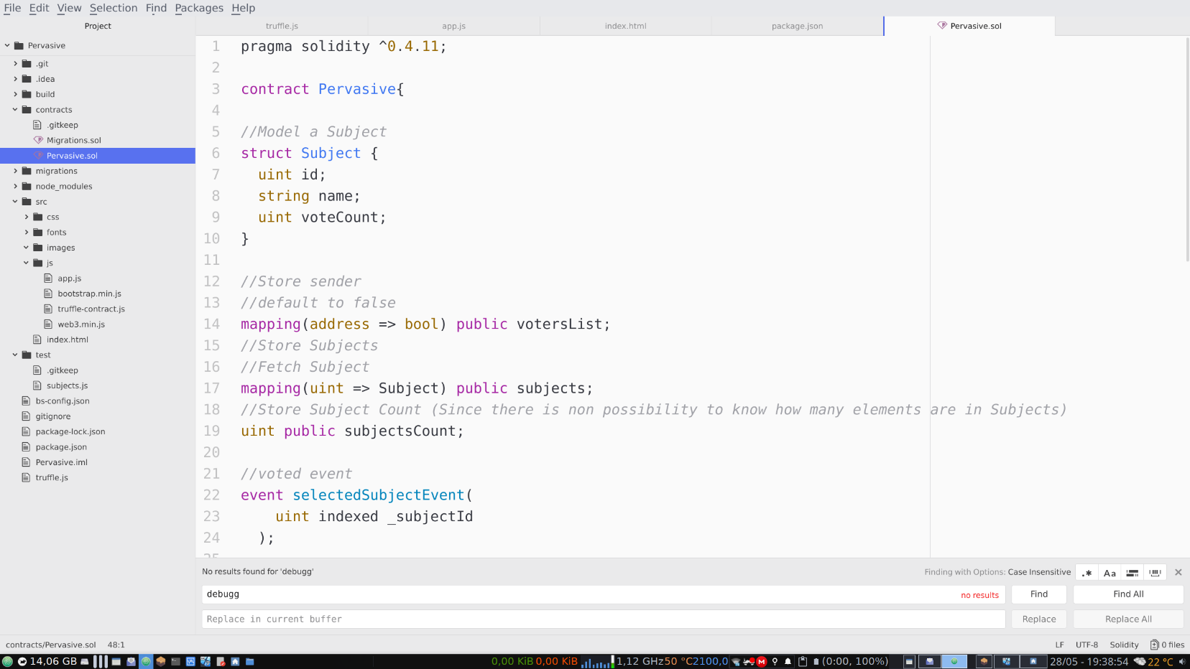
Pervasive Dapp!
What is needed?
Smart Contract
Javascript client side
Javascript test
MetaMask plugin
Local Etherium Network

Slide 13
Pervasive Dapp DEMO
Notes:
Cost gas
Local network
Javascript test

Slide 14
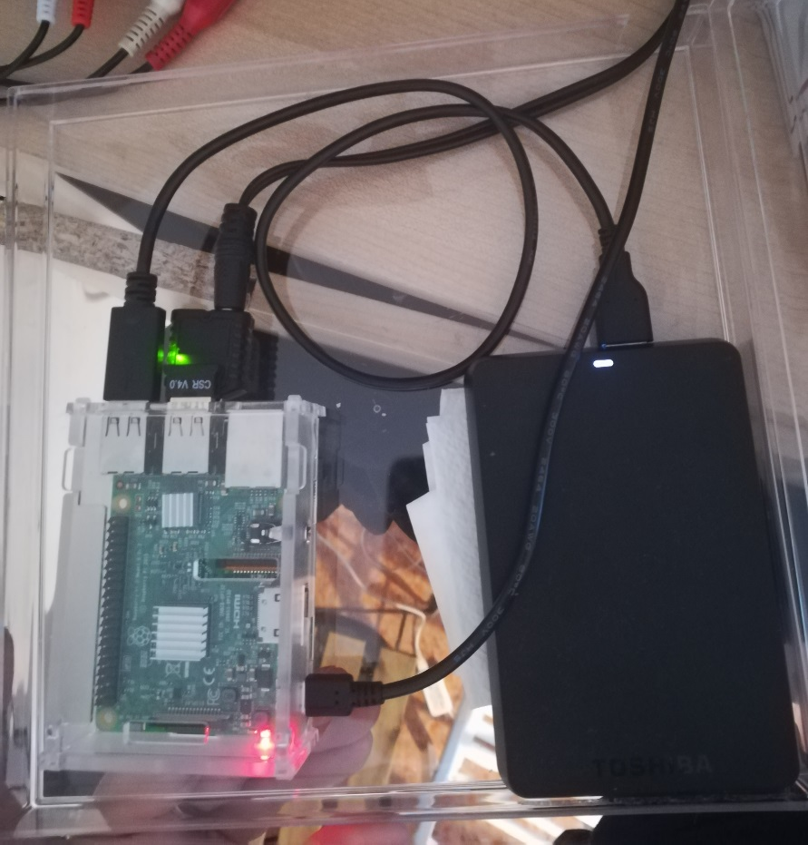
Thank you!
The Ethereum node on my Raspberry!

